Slide 1

问题求解与实践
——GUI编程（5）
主讲教师： 陈雨亭、沈艳艳

Slide 2
Chapter 16
Graphical User Interfaces
Bjarne Stroustrup
www.stroustrup.com/Programming

Slide 3
Overview
Perspective
  I/O alternatives
  GUI
  Layers of software
GUI example
GUI code
  callbacks
Stroustrup/Programming

Slide 4
I/O alternatives
Use console input and output
  A strong contender for technical/professional work
  Command line interface
  Menu driven interface
Graphic User Interface
  Use a GUI Library
  To match the “feel” of windows/Mac applications
  When you need drag and drop, WYSIWYG
  Event driven program design
  A web browser – this is a GUI library application
    HTML / a scripting language
    For remote access (and more)
Stroustrup/Programming

Slide 5
Common GUI tasks
Titles / Text
  Names
  Prompts
  User instructions
Fields / Dialog boxes
  Input
  Output
Buttons
  Let the user initiate actions
  Let the user select among a set of alternatives
    e.g. yes/no, blue/green/red, etc.
Stroustrup/Programming

Slide 6
Common GUI tasks (cont.)
Display results
  Shapes
  Text and numbers
Make a window “look right”
  Style and color
    Note: our windows look different (and appropriate) on different systems
More advanced
  Tracking the mouse
  Dragging and dropping
  Free-hand drawing
Stroustrup/Programming

Slide 7
GUI
From a programming point of view GUI is based on two techniques
  Object-oriented programming
    For organizing program parts with common interfaces and common actions
  Events
    For connecting an event (like a mouse click) with a program action
Stroustrup/Programming

Slide 8
Layers of software
When we build software, we usually build upon existing code
Example of a layer
  Provides services
  Uses services
Our program
Our GUI/Graphics interface library
FLTK
The operating system Graphics GUI facilities
Device driver layer
Stroustrup/Programming

Slide 9
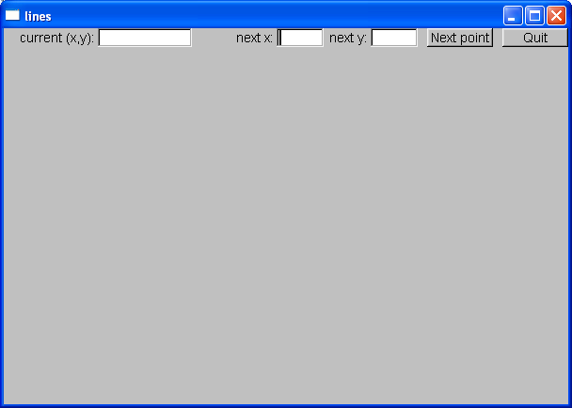
GUI example
Window with
  two Buttons, two In_boxes, and an Out_box
Stroustrup/Programming

Slide 10
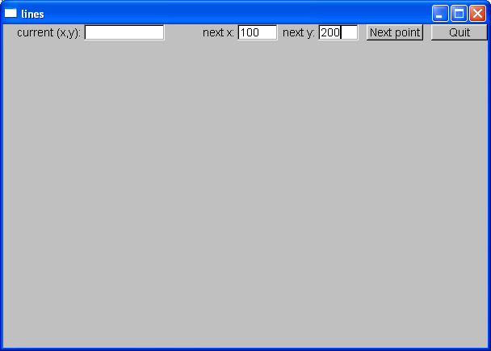
GUI example
Enter a point in the In_boxes
Stroustrup/Programming

Slide 11

GUI example
When you hit Next point that point becomes the current (x,y) and is displayed in the Out_box
Stroustrup/Programming

Slide 12

GUI example
Add another point and you have a line
Stroustrup/Programming

Slide 13

GUI example
Three points give two lines
  Obviously, we are building a polyline
Stroustrup/Programming

Slide 14
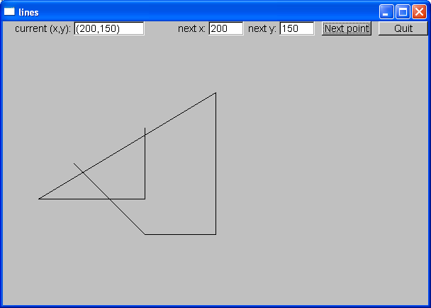
GUI example
And so on, until you hit Quit.
Stroustrup/Programming

Slide 15
So what? And How?
We saw buttons, input boxes and an outbox in a window
  How do we define a window?
  How do we define buttons?
  How do we define input and output boxes?
Click on a button and something happens
  How do we program that action?
  How do we connect our code to the button?
You type something into a input box
  How do we get that value into our code?
  How do we convert from a string to numbers?
We saw output in the output box
  How do we get the values there?
Lines appeared in our window
  How do we store the lines?
  How do we draw them?
Stroustrup/Programming

Slide 16
Mapping
We map our ideas onto the FTLK version of the conventional Graphics/GUI ideas
Stroustrup/Programming

Slide 17
Define class Lines_window
struct Lines_window : Window // Lines_window inherits from Window
{
Lines_window(Point xy, int w, int h, const string& title); // declare constructor
Open_polyline lines;
private:
Button next_button; // declare some buttons – type Button
Button quit_button;
In_box next_x; // declare some i/o boxes
In_box next_y;
Out_box xy_out;
void next(); // what to do when next_button is pushed
void quit(); // what to do when quit_botton is pushed
static void cb_next(Address, Address window); // callback for next_button
static void cb_quit(Address, Address window); // callback for quit_button
};
Stroustrup/Programming

Slide 18
GUI example
Window with
  two Buttons, two In_boxes, and an Out_box
Stroustrup/Programming

Slide 19
The Lines_window constructor
Lines_window::Lines_window(Point xy, int w, int h, const string& title)
:Window(xy,w,h,title),
// construct/initialize the parts of the window:
// location size name action
next_button(Point(x_max()-150,0), 70, 20, "Next point", cb_next),
quit_button(Point(x_max()-70,0), 70, 20, "Quit", cb_quit), // quit button
next_x(Point(x_max()-310,0), 50, 20, "next x:"), // io boxes
next_y(Point(x_max()-210,0), 50, 20, "next y:"),
xy_out(Point(100,0), 100, 20, "current (x,y):")
{
attach(next_button); // attach the parts to the window
attach(quit_button);
attach(next_x);
attach(next_y);
attach(xy_out);
attach(lines); // attach the open_polylines to the window
}
Stroustrup/Programming

Slide 20
Widgets, Buttons, and Callbacks
A Widget is something you see in the window which has an action associated with it
A Button is a Widget that displays as a labeled
rectangle on the screen, and when you click on the
button, a Callback is triggered
A Callback connects the button to some function or functions (the action to be performed)
Stroustrup/Programming

Slide 21
Widgets, Buttons, and Callbacks
// A widget is something you see in the window
// which has an action associated with it
// A Button is a Widget that displays as a labeled rectangle on the screen;
// when you click on the button, a Callback is triggered
// A Callback connects the button to some function
struct Button : Widget {
Button(Point xy, int w, int h, const string& s, Callback cb)
:Widget(xy,w,h,s,cb) { }
};
Stroustrup/Programming

Slide 22
How it works
Window
Describe where the button is
Describe what the button looks like
Register Button’s callback
Attach Button
Our code
FLTK
Call “callback” when Button is pressed
Stroustrup/Programming

Slide 23
GUI example
Add another point an you have a line
Stroustrup/Programming

Slide 24
Widget
A basic concept in Windows and X windows systems
  Basically anything you can see on the screen and do something with is a widget (also called a “control” by Microsoft)
  struct Widget {
  Widget(Point xy, int w, int h, const string& s, Callback cb)
  :loc(xy), width(w), height(h), label(s), do_it(cb)
  { }
  // … connection to FLTK …
  };
Stroustrup/Programming

Slide 25
Button
A Button is a Widget that
  displays as a labeled rectangle on the screen;
  when you click on it, a Callback is triggered
struct Button : Widget {
Button(Point xy, int w, int h, const string& s, Callback cb)
:Widget(xy,w,h,s,cb) { }
};
Stroustrup/Programming

Slide 26
Callback
Callbacks are part of our interface to “the system”
  Connecting functions to widgets is messy in most GUIs
  It need not be, but
    “the system” does not “know about” C++
    the style/mess comes from systems designed in/for C/assembler
    Major systems always use many languages; this is one example of how to cross a language barrier
  A callback function maps from system conventions back to C++
void Lines_window::cb_quit(Address, Address pw)
// Call Lines_window::quit() for the window located at address pw
{
reference_to<Lines_window>(pw).quit(); // now call our function
}
Map an address into a reference to the type of object residing at that address – to be explained the following chapters
Stroustrup/Programming

Slide 27
Our “action” code
// The action itself is simple enough to write
void Lines_window::quit()
{
// here we can do just about anything with the Lines_window
hide(); // peculiar FLTK idiom for “get rid of this window”
}
Stroustrup/Programming

Slide 28
The next point function
// our action for a click (“push”) on the next point button
void Lines_window::next()
{
int x = next_x.get_int();
int y = next_y.get_int();
lines.add(Point(x,y));
// update current position readout:
stringstream ss;
ss << '(' << x << ',' << y << ')';
xy_out.put(ss.str());
redraw(); // now redraw the screen
}
Stroustrup/Programming

Slide 29
In_box
// An In_box is a widget into which you can type characters
// Its “action” is to receive characters
struct In_box : Widget {
In_box(Point xy, int w, int h, const string& s)
:Widget(xy,w,h,s,0) { }
int get_int();
string get_string();
};
int In_box::get_int()
{
// get a reference to the FLTK FL_Input widget:
Fl_Input& pi = reference_to<Fl_Input>(pw);
// use it:
return atoi(pi.value()); // get the value and convert
// it from characters (alpha) to int
}
Stroustrup/Programming

Slide 30
Control Inversion
But where is the program?
  Our code just responds to the user clicking on our widgets
  No loops? No if-then-else?
“The program” is simply
  int main ()
  {
  Lines_window win(Point(100,100),600,400,”lines”);
  return gui_main(); // an “infinite loop”
  }
Stroustrup/Programming

Slide 31
Control Inversion
Application
call
Input function
prompt
User responds
Application
callback
System
click
User “action”
Stroustrup/Programming

Slide 32
Summary
We have seen
  Action on buttons
  Interactive I/O
    Text input
    Text output
    Graphical output
Missing
  Menu (See Section 16.7)
  Window and Widget (see Appendix E)
  Anything to do with tracking the mouse
    Dragging
    Hovering
    Free-hand drawing
What we haven’t shown, you can pick up if you need it
Stroustrup/Programming

Slide 33
Next lecture
The next three lectures will show how the standard vector is implemented using basic low-level language facilities.
This is where we really get down to the hardware and work our way back up to a more comfortable and productive level of programming.
Stroustrup/Programming

